Slide 1
" Restoring Self-Respect and Building Hope"

Slide 2
Adolescent Services and Treatment Overview
Over the last two years, Focus Counselling Services has received nineteen referrals for adolescent services.
Out of the nineteen referrals, Focus provided outpatient treatment to eight individuals.
Age range: 11 to 18 years old, average age being 17 years old.
Six persons refused services and five reported occasional use and therefore did not met the threshold for SUD.
The common substances identified or admitted to by participants include alcohol, cannabis, ecstasy, and inhalants.
Notably, as participants approach 18 years old, they are less likely to continue treatment beyond this age.
Two of the eight participants are currently on their recovery journey, with one set to head of to university next year.
The majority of participants reported regular cannabis use.
Half of the participants reported poly-substance use.
All participants reported that substances are easily accessible.
Focus Counselling Services believes that early identification and referral can lead to increased engagement and improved treatment outcomes.
Noted barriers to treatment success are environment, myths about the effects of continued substance use, parent or caregiver perceptions of substance use.

Slide 3
Adolescent and Young Adult
Substance Use Disorder Treatment
Focus Counselling Services offers a flexible 10–16-week outpatient treatment program.
The program's length is tailored to individual needs and progress.
Targeted at adolescents aged 12 to 18 years.
Program length is based on the unique needs of each participant.
Progress monitoring ensures that treatment aligns with individual goals.
Participants can choose between individual or group therapy, based on their preferences and requirements.
Focus Counselling Services provides a holistic approach to address various behavioral and emotional challenges faced by adolescents.
The goal is to support adolescents in achieving positive, lasting change in their lives.

Slide 4
Referral Sources
Family Members
Church Members & Clergy
Department of Child and Family Services
Treatment Agency's

Slide 5
Keep It Direct and Simple - KIDS
Focus Counselling Services utilizes 10 specialized interactive journals by The Change Companies, tailored for adolescents in addiction treatment programs.
"Keep It Direct and Simple" - A nonjudgmental focus on core concepts with a strength-based perspective.
This approach encourages positive, lasting change in adolescents' lives.
Designed to address the unique needs of adolescents in treatment.
Adolescents will explore the challenges that led them to treatment.

Slide 6
Keep It Direct and Simple - Cont.
Participants gain practical tools and skills to foster meaningful, lasting change.
The journals offer a comprehensive approach that acknowledges the importance of mental health and addiction treatment in adolescent lives.
Focusing on strengths and positivity can motivate adolescents to make meaningful changes.
discussion on the potential positive outcomes, such as improved mental health and sustained recovery are held.
our approach and goal is to empower adolescents to address their issues and equip them with the tools to lead healthier, more fulfilling lives.

Slide 7
Interactive Journaling®
Evidence-Based Behavior Change
Interactive Journaling® is an evidence-based practice guiding individuals toward positive life changes.
Client-Centered, goal-directed approach assists participants in modifying behavior as they progress through the stages of change (Prochaska & Prochaska, 2016).
Utilizes evidence-based practices, including expressive writing, motivational interviewing, cognitive-behavioral therapy, and the transtheoretical model of behavior change.
Consistent across all Journals, even with varying target behaviors.
Nonconfrontational questions in participant Journals prompt self-reflection and exploration.
Encourages motivation for change, consideration of options, and the development of behavior-related goals with timelines.
Interactive Journaling® is flexible and applicable to diverse populations and settings.
Empowers individuals on their journey toward positive life changes.

Slide 8
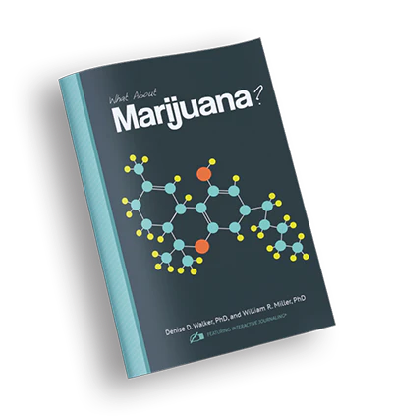
What About Cannabis/Marijuana?
Cannabis is often used alongside alcohol and other substances that lead people into treatment.
This program is designed to address cannabis use among both youth and adults.
It encourages individuals to reflect on their cannabis use and make informed decisions about their future actions.
Explore the role of cannabis in one's life.
Encourage thoughtful consideration of the consequences and potential need for change.
Acknowledges that cannabis use often co-occurs with other substances.
Offers a nonjudgmental space for individuals to assess their choices regarding cannabis.
The program also aims to empower individuals to make informed decisions about their cannabis use.
Encourages dialogue and support for those seeking clarity about their relationship with Cannabis.

Slide 9
Keep It Direct and Simple
Q&A
Focus Counselling Services
“Jerrys House #7 Barry Road
St. George GE04
441-2-2196
https://www.focus.bm
Info.focus@focus.bm

