Slide 1

Update on the
DNDC’s Survey Initiatives
2018 ANNUAL MEETING OF THE
BERMUDA DRUG INFORMATION NETWORK
Stephanie Tankard
Research Officer
DNDC
Princess Victoria Room
Hamilton Princess Hotel
18th & 19th, October 2018

Slide 2

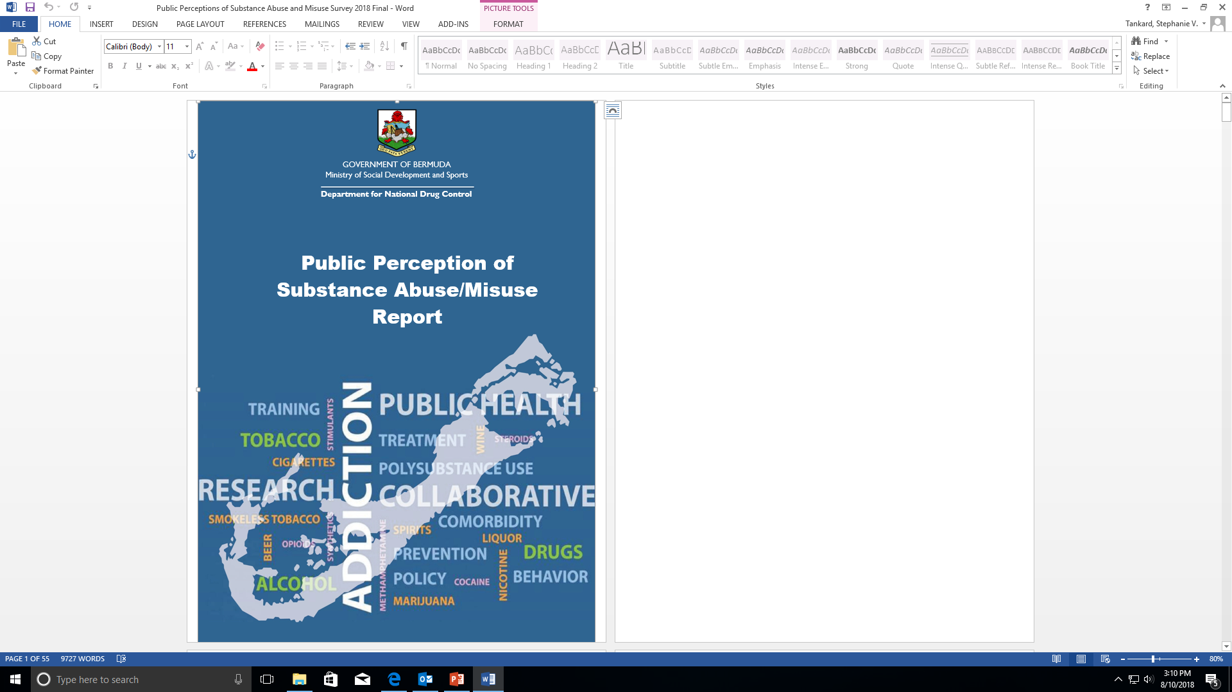
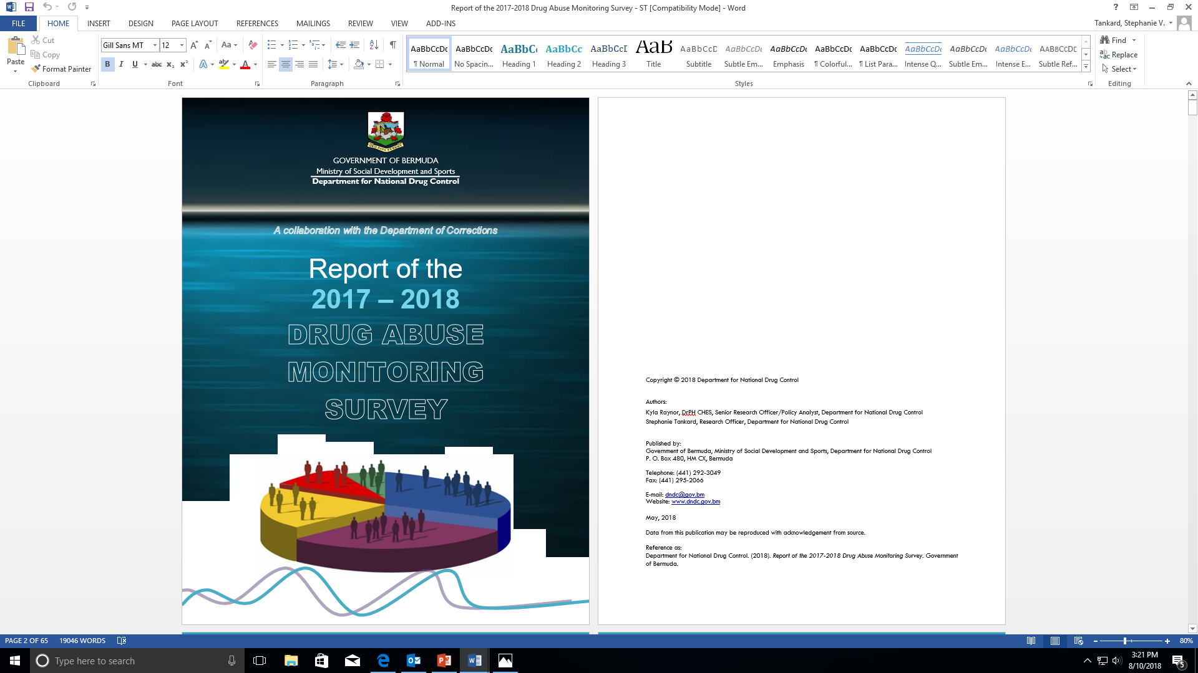
Our Mission
“Lead efforts to reduce alcohol and drug misuse through education, research, advocacy, service delivery, and inter-agency/department coordination.
  Public Perception of Substance Abuse/Misuse
  Drug Abuse Monitoring Survey (Prison Survey)

Slide 3
PUBLIC PERCEPTION SURVEY
Purpose: to inform policy makers on the public’s opinions and beliefs regarding prevention and treatment of substance abuse/misuse. It aims to identify characteristics and social factors that are associated with drug misuse and abuse.
Method:
Computer assisted telephone method, using a web-based system called Survey Monkey.
Participation:
The general public
Sample size=501
16 years and older
Response Rate:
100%
Survey Administration:
March 21st to March 28th

Slide 4
SURVEY DESIGN
  Demographics
  Concern and Awareness
  Social and Retail Availability
  Law Enforcement
  Consequences of Drug Use
  Substance Abuse-Treatment
  Substance Abuse-Prevention
Notes:
This report is broken down into 7 sections which are:

Slide 5
DEMOGRAPHICS
March 2018
56.1% female
39.4 % 46-64 years old
52.7% married
55.7% black
15.6% Pembroke
34.7% High School Diploma
40.8% employed/self-employed, working 40 or more hours per week
Notes:
The Perception Survey took place in March of this year.
Of the 501 that were sampled…

Slide 6
CONCERN AND AWARENESS
Alcohol is perceived to be the most abused/ misused substance in Bermuda (92.9%)
Marijuana perceived as one of the top two substances most likely used by most age groups (78.0%)
Concern for Drug and Alcohol Abuse in the Community (%)
 | Alcohol | Drugs
Not at all concerned | 8.2 | 6.4
Somewhat concerned | 14.5 | 15.9
Concerned | 24.3 | 24.1
Very Concerned | 52.9 | 53.6
People personally know others who used alcohol and marijuana (97.4%)
Growing support for non-criminal penalties for cannabis use (60.0%)
Notes:
The first section of the questions were focused on the public’s concern and awareness.
Majority expressed that they were very concerned about drug and alcohol abuse in the community.
With alcohol perceived as the most abused/misused drug in Bermuda and marijuana being one of the top two substances used by most age groups.
Even though the majority of the population knew users there was a growing support for …

Slide 7
SOCIAL AND RETAIL AVAILABILITY
Easy to Access(%)
Difficult to Access(%)
Alcohol
98.2
Solvents 53.9
Marijuana
52.6
Ecstasy
33.9
Heroin
32.1
Cocaine
31.3
Ease of Access to Substances (%)
Legal substances can be obtained in an hour or less.
Alcohol 95.1%
Notes:
In relation to social and retail availability the population felt that alcohol was the easiest to access whilst ecstasy was noted to be the most difficult.

Slide 8
LAW ENFORCEMENT
More Severe Legal Penalties for Drink Driving (%)
Ways Public Authorities can reduce drug and alcohol problems
Provide education & awareness
Provide control of drug and alcohol use through laws
Tougher regulations
Ways to Control or Regulate Personal or Recreational Cannabis Use
Banning cannabis (Use around children)
Legalize it
Regulate it (Government to create licensed dispensaries)
Decriminalization(public fine, setting limits on amount used)
Notes:
With the high number of road fatalities linked to drink driving or under the influence of another substance, nearly all persons were in support of more sever legal penalties for drink driving.
These next two were open ended questions which allowed respondents to answer more freely.

Slide 9
CONSEQUENCES OF DRUG USE
Ways Drug abuse is a serious problem/How abuser’s actions affect themselves & others
How to support loved ones addicted to alcohol/drugs
Addiction
Crime
Health issues/death
Destruction of family unit
Financial hardships (job loss)
Need for:
Counseling
Education
Support Groups
Notes:
Open ended questions
There is a need for…

Slide 10
SUBSTANCE ABUSE-TREATMENT
Referring Someone
MAWI
Treatment Availability
Treatment should be made available to all drug users according to their needs.
97.2% Agreed
Turning Point
HarbourLight- Salvation Army
Referring Someone Who Needs Treatment (%)
Notes:
Most persons did not know where to refer someone who needs treatment and felt that treatment should…
The three agencies that were repeatedly mentioned as places to refer someone were:

Slide 11
SUBSTANCE ABUSE-PREVENTION
Awareness of Prevention Strategies
CADA
Type of Prevention Strategies
33.3% Alcohol Prevention Strategies
Drive for Change Campaign
Knowledge of Prevention Strategies
73.0% not aware of Prevention Strategies in Bermuda
18.6% Marijuana Prevention Strategies
Notes:
A large % of the population stated that they were not aware of prevention strategies in Bermuda.
With CADA and Drive for Change Campaign being the prevention strategies people were aware of.
Most said that they had heard of alcohol strategies.

Slide 12
SURVEY DESIGN
  Demographic Characteristics
  Drug Use and Drug Screening
  Mental Health, Drug Overdose and Substance Abuse Treatment
  Criminal Record
  HIV/AIDS and Hepatitis B Status and Abuse History
  Drug Prices
  Drug Abuse Screening Test (DAST)
  Gang Involvement
Notes:
This report was broken into 8 sections which correspond to the sections of the questionnaire that was administered.

Slide 13
PRISON SURVEY
Purpose: to monitor drug consumption among the high risk inmate population; to classify of offenders based on level of severity of substance abuse problems; and to gauge drug consumption and criminality among this particular subset over a longer duration.
Collaboration:
Department of Corrections
Questions:
DAST & Standardised questionnaire
- Drug use
- Criminal record
- Drug market
- Urine test
Method:
Paper & Pencil
Personal Interview
Participation:
Reception inmates at Westgate &
Co-Ed
From April 2017 to March 2018
(n=230 inmates)
Notes:
It is conducted every 2 years
Data collection period lasts 1 year
The DNDC collaborate with the…
DAST= Drug Abuse Screening Test
The questionnaire is structured to mimic the DAST that asks questions concerning offenders involvement with drugs.
It is administered by (method)… with a face to face personal interview
This survey is a voluntary one that is conducted on inmates upon their reception to the facility.

Slide 14
DEMOGRAPHICS
Westgate facility 88.1%
93.8% male
66.7 % 31-35 years old
85.5% single
82.4% black
21.9% Pembroke
41.2% High School Diploma
39.5% working part-time (<36 hours)
36.0% Construction Industry
Notes:
Of the 230 participants majority were housed at the Westgate facility and were between the ages of 31-35 who were working part time at the time of their arrest.
2. Co-ED is the other facility

Slide 15
DRUG USE AND DRUG SCREENING
Drug Use:
Lifetime Use: Alcohol 78.7%
Average Age: Marijuana 14 yrs.
Current Use: Alcohol 54.8%
Lifetime and Current Prevalence of Substance Use by Proportion of Respondents
SUBSTANCE | LIFETIME USE (%) (n = 230) | AVERAGE AGE OF FIRST USE (YEARS) | CURRENT USE (%) (n = 230) | AVERAGE NUMBER OF DAYS USED IN LAST 30 DAYS
Cigarettes/Tobacco | 70.4 | 14.3 | 53.0 | 22.3
Alcohol | 78.7 | 15.3 | 54.8 | 11.4
Marijuana | 76.5 | 14.0 | 53.0 | 18.4
Crack Cocaine | 25.7 | 22.7 | 11.7 | 14.2
Cocaine Powder | 23.0 | 21.7 | 3.0 | 6.5
Heroin | 17.8 | 21.2 | 8.3 | 20.8
Ecstasy | 20.4 | 22.3 | 1.7 | 5.2
LSD | 6.5 | 19.9 | - | -
Methamphetamine | 1.7 | 19.3 | - | -
Valium/Benzodiazepine | 3.5 | 32.9 | - | -
Methadone | 7.8 | 34.2 | 2.2 | 14.6
Other Street Drugs | 8.3 | 22.9 | 1.3 | 1.6
Drug Screening (tested positive):
Marijuana 73.5%
Opiate 27.9%
Cocaine 23.0%
Notes:
In reference to drug use:
Majority of the inmates stated that they used alcohol in their lifetime and in the 30 days prior to the survey.
Marijuana came in as the youngest age of first use at 14 years old.
2. When it came to drug screenings which are collected using urine samples, most inmates tested positive for marijuana.

Slide 16
MENTAL HEALTH, DRUG OVERDOSE, & SUBSTANCE ABUSE TREATMENT
Substance abuse treatment and counseling
Prescribed medication for mental or emotional problems in the past year
7.8% of respondents indicated that they took prescribed medication for mental or emotional problems in the past year.
29.1% of respondents indicated that they received substance abuse counseling or rehabilitation treatment as a result of their use of alcohol and/or drug use.
Notes:
1. Whilst most inmates did not report that they took prescription medication for mental and emotional problems in the past year 7.8% indicated that they had.

Slide 17
CRIMINAL RECORD
DRUGS
ALCOHOL
Proportion of Respondents by Outcome of Category of Offence
Most participants had been to prison between 2-5 times (29.1%)
OFFENCE | OUTCOME (% RESPONDENTS)
 | PRISON | FINE | PROBATION
Violent | 24.3 | 2.2 | 14.8
Property | 17.4 | 1.7 | 10.0
Drug | 10.4 | 4.8 | 4.8
Public Order | 15.2 | 15.2 | 6.5
Other | 9.1 | 7.4 | 2.6
Violent: 24.3% (Prison)
Public Order: 15.2% (Fine)
Violent: 14.8% (Probation)
Drug and Alcohol Connection
Current Offence: 27.4% Drugs
Previous Offence: 27.8% Drugs
Notes:
Of the surveyed inmates:
Most or 24.3% were in prison for violent offences, which also ranked high for those who were on probation.
Fines were mostly given for offences of Public Order.

Slide 18
HIV/AIDS & HEPATITIS B STATUS & ABUSE HISTORY
Abuse
Physical Abuse: 8.7% by age 18 years.
HIV/AIDS & Hepatitis
Majority of participants were not HIV positive (97.3%) and did not have Hepatitis B (96.8%).
Self-reported History of Physical Abuse, Sexual Abuse, Neglect, and Abandonment
TYPE OF ABUSE | n | %
Physical Abuse | 20 | 8.7
Sexual Abuse | 18 | 7.8
Neglect | 17 | 7.4
Abandonment | 15 | 6.5
Notes:
There was a correlation/relationship shown between the 4 types of abuse and crack cocaine with:
Of the respondents who admitted to being physically abused as a child, prior to being 18 years:
50.0% had ever used crack cocaine in their lifetime
Of those being sexually abuse as a child, prior to being 18 years:
50% had ever taken or used crack in their lifetime
94.1% said they had ever used marijuana
Of the respondents who were neglected by parents at age 5:
52.9% had ever taken or used crack cocaine in their lifetime
Of the respondents who were abandoned by parents at age 5:
40.0% had ever taken or used crack cocaine
Interestingly, 8.7% of this population reported that they had been abused by the age of 18.

Slide 19
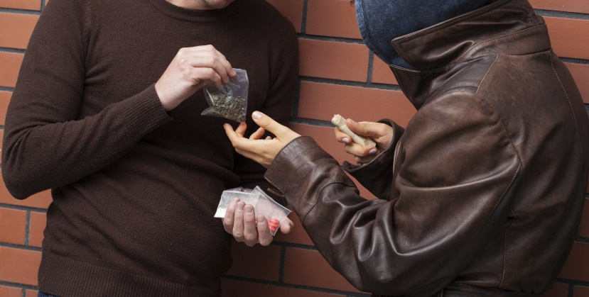
DRUG PRICES
Drug Prices 2017/2018
Substance | Mean Price ($) | Number of Persons
Cannabis (ounce) | 634 | 85
Cannabis (gram) | 58 | 74
Cannabis Resin (gram) | 99 | 34
Cocaine (ounce) | 2,632 | 30
Cocaine (rock) | 65 | 10
Crack (rock) | 78 | 14
Heroin (gram) | 374 | 22
Heroin (deck) | 48 | 8
Notes:
It is important to note that, the reported drug prices seemed very volatile even though all inmates were unable to give a response to this question.
Despite the instability of drug process reported, they do, however, add to the existing data on drug prices from other primary/secondary sources.

Slide 20
DRUG MARKET
Drug Market in Past Year and Month
20.0% indicated they had “heard” of other drugs being used on the street.
Other Drugs* Used
Acid | Hydromorphone
Aerosol spray | K2/ Synthetic Marijuana/Spice
Barbiturates | Lean
Bath Salts | Marley
Black coloured mix of dope and cocaine | MDA
Codeine | Mushroom
Desomorphine (Krokodil) | Parachutes (MDMA & Crystal Meth)
Dimethltryptamine (DMT) | Salvia
Fentanyl | Special K
Flakka | Wet
Glue | Xanax
Notes:
1. On the bar chart we can see that there was a higher proportion who brought drugs rather than sold them in the past month and year.
Brought Illegal Drugs in past year: 46.5%
Brought Illegal Drugs in past month: 39.1% (during the past 30 days prior to being arrested)
Sold illegal drugs to make money in the past 12 months: 18.3% or 42 people indicated they had sold drugs.
Selling illegal drugs during the past 30 days, prior to being arrested, 14.8% (n = 34), admitted they had sold drugs.
2. Of the 20% that… these are some of the other drugs that were reported to be used.

Slide 21
DRUG ABUSE SCREENING TEST
Proportion of Respondents by Level of Severity of Substance Abuse (n = 230)
 | LEVEL OF SEVERITY | % RESPONDENTS
 | None (0) | 20.4
 | Low (1-5) | 34.3
Substance abuse or dependence | Intermediate (6-10) | 24.3
 | Substantial (11-15) | 13.5
 | Severe (16-20) | 7.4
Note: not stated responses were not included in the table.
Prior to their current arrests and incarceration:
No substance abuse problems: 20.4%
Low substance abuse problems: 34.3%
Intermediate to severe drug abuse problems: 45.2%
About two out of every five inmates, requires some type of assistance or intervention for substance abuse problems.
Notes:
1. DAST asks questions concerning offenders involvement with drugs.
A low score, however, does not necessarily mean that the offender is free of drug-related problems. There are other factors which must also be considered, for example, the length of time the person has been using drugs, their age, level of consumption, and other data collected in the survey in order to interpret the DAST scores.
According to the American Society of Addiction Medicine Placement Criteria (ASAM), those offenders with no reported substance abuse problem will require monitoring, those 34.3% with a low score will require brief counseling, those 24.3% with intermediate scores will require some form of intensive outpatient treatment, and those 13.5% and 7.4% respectively, whose scores were in the substantial and severe categories will require intensive treatment.

Slide 22
GANG INVOLVEMENT
20.4% (47) admitted to having friends or family members belonging to a gang.
13.5% (31) of respondents admitted to belonging to a gang themselves.
Notes:
1. Our last section of the report discusses: Gang Involvement

Slide 23
Thank You!
Questions
Princess Victoria Room, Fairmont Hamilton Princess Hotel
18th & 19th, October 2018
Stephanie Tankard
Research Officer
DNDC

